Slide 1
Logistic regression
FEATURES
Account Status
Duration
Credit History
Purpose
Credit Amount
Savings Account
Unemployed
Installment Rate
Debtors/guarantors
Present Residence Since
Property
Age
Other Installment Plans
Housing
Credits
Job

Slide 2
logistic regression
CLASSIFICATION REPORTS
Grid search
optimization
precision recall f1-score support
Bad 0.71 0.74 0.72 173
Good 0.73 0.70 0.72 177
Accuracy 0.72 350
Macro Avg 0.72 0.72 0.72 350
Weighted Avg 0.72 0.72 0.72 350
precision recall f1-score support
Bad 0.72 0.75 0.73 173
Good 0.75 0.71 0.73 177
Accuracy 0.73 350
Macro Avg 0.73 0.73 0.73 350
Weighted Avg 0.73 0.73 0.73 350

Slide 3
logistic regression
CLASSIFICATION REPORTS WITH DUMMY ENCODED DATA
Grid search
optimization
precision recall f1-score support
Bad 0.72 0.76 0.74 173
Good 0.75 0.72 0.73 177
Accuracy 0.74 350
Macro Avg 0.74 0.74 0.74 350
Weighted Avg 0.74 0.74 0.74 350
precision recall f1-score support
Bad 0.69 0.77 0.73 173
Good 0.75 0.66 0.70 177
Accuracy 0.71 350
Macro Avg 0.72 0.71 0.71 350
Weighted Avg 0.72 0.71 0.71 350

Slide 4
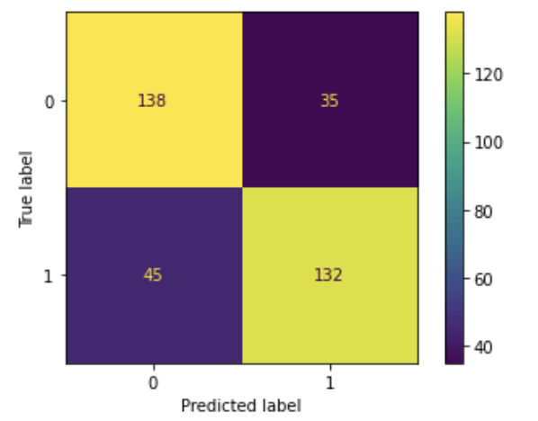
Confusion matrix according the cost matrix associated with this dataset It is worse to class a customer as good when they are bad , than it is to class a customer as bad when they are good .

Slide 5
Bias in artificial intelligence
While it may be a significant improvement on making decisions through pure human subjectivity, banks still need to be concerned with the prevention of bias on the part of the programmer that may be intentional or unintentional
Steps like omitting unnecessary attributes like sex and foreign worker status can possibly prevent the algorithm from making a biased decision
A human review should be conducted of the predictions made by the machine learning algorithm to ensure fairness and protection against bias decisions.

